Slide 1

INTEGRATED DEVELOPMENT ENVIRONMENT ( IDE )
Submitted in partial fulfillment of award of Degree of Bachelor of Technology
in
Computer Science Engineering
By:
CHANPREET SINGH(10/CSE-2/2008)
GURJEET SINGH (26/CSE-2/ 2008 )
PRATEEK JEET SINGH (27/CSE-2/ 2008 )
Guided by:-
Megha Chauhan
Department Of Computer Science Engineering
Guru Tegh Bahadur Institute of Technology
Guru Gobind Singh Indraprastha University

Slide 2
CONTENTS
Introduction
Technology used
Project Requirement
Need of IDE
Architecture
Features of IDE
Future Prospects
References

Slide 3
INTRODUCTION
Integrated development environment (IDE) (also known as integrated design environment, integrated debugging environment or interactive development environment) is a software application that provides comprehensive facilities to computer programmers for software development. An IDE normally consists of:
Source code editor
Compiler
Interpreter
Debugger

Slide 4
TECHNOLOGY USED
Operating system : Window 7
Languages : Java(J2SE)
Tools : Net Beans 6.9.1
Database : MS Access and MySQL
files : Jar Files

Slide 5
PROJECT REQUIREMENT
HARDWARE REQUIREMENTS
SYSTEM REQUIREMENTS
PROCESSOR: Pentium IV or higher
RAM: 512MB or higher
DISK SPACE : 4 GB or higher
SOFTWARE REQUIREMENTS
Net Beans (any version )
JDK ( Java Development toolkit )
JVM ( Java Virtual Machine )

Slide 6
NEED OF IDE
The project “Integrated development Environment” is aimed at providing an user friendly environment for writing Java Programs and Compiling & Interpreting the same.
IDE is designed to maximize programmer productivity by providing tightly-knit components with similar user interfaces. However, because an IDE is a complicated piece of software by its very nature, this higher productivity only occurs after a lengthy learning process.

Slide 7
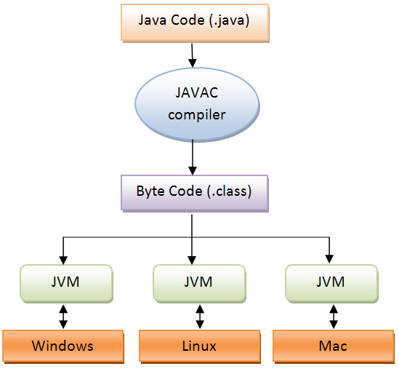
ARCHITECTURE

Slide 8
WHY ide??
Features :-
EMBEDDED COMPILER
Embedded interpreter
Security
Portability
Graphical user interface ( gui )
DATABASE CONNECTIVITY
FEATURES LIKE UNDO, REDO ETC.

Slide 9
Working of ide…

Slide 10
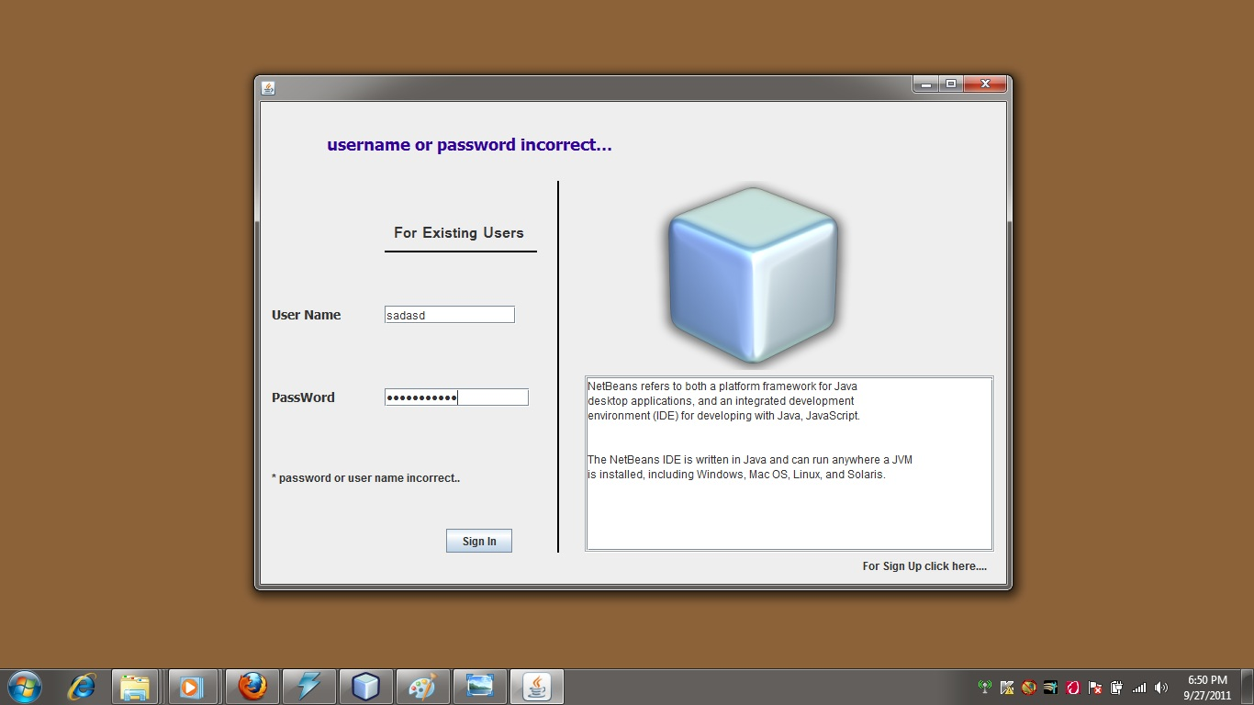
1) User Authentication ..

Slide 11
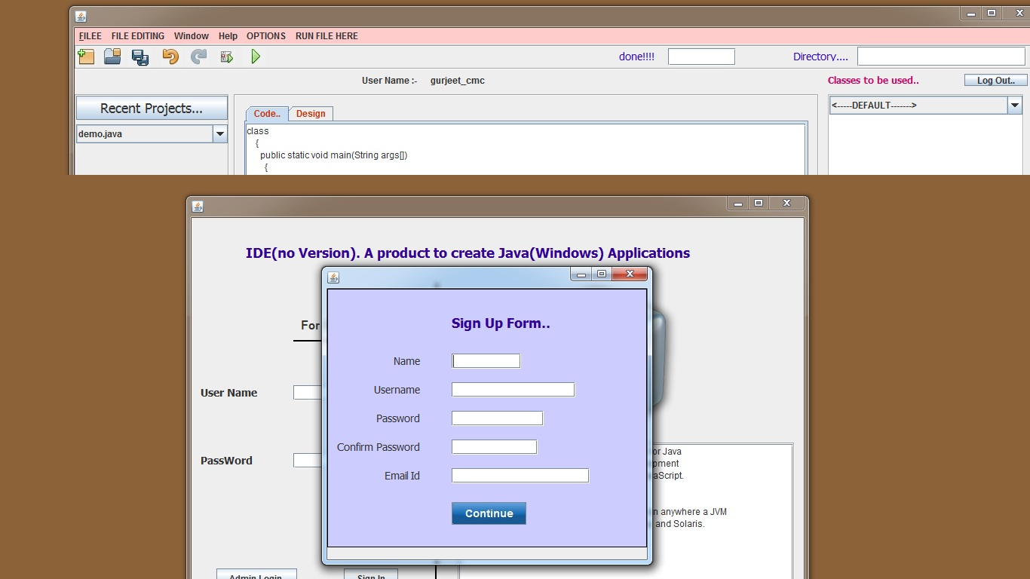
Sign Up form..

Slide 12
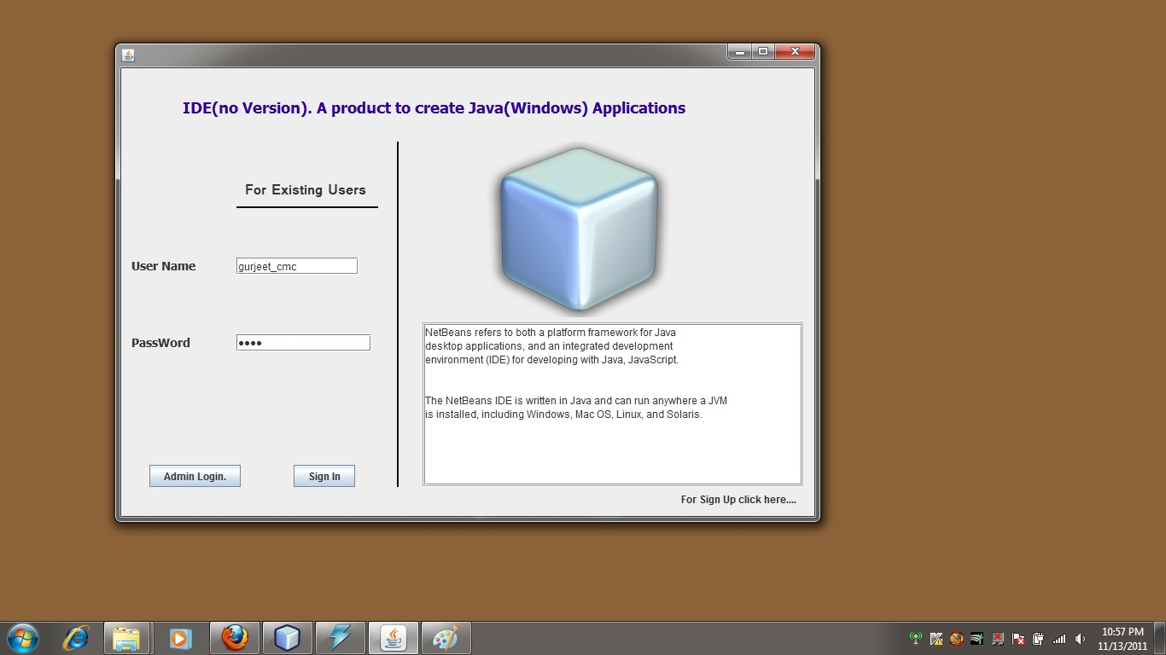
continue..

Slide 13
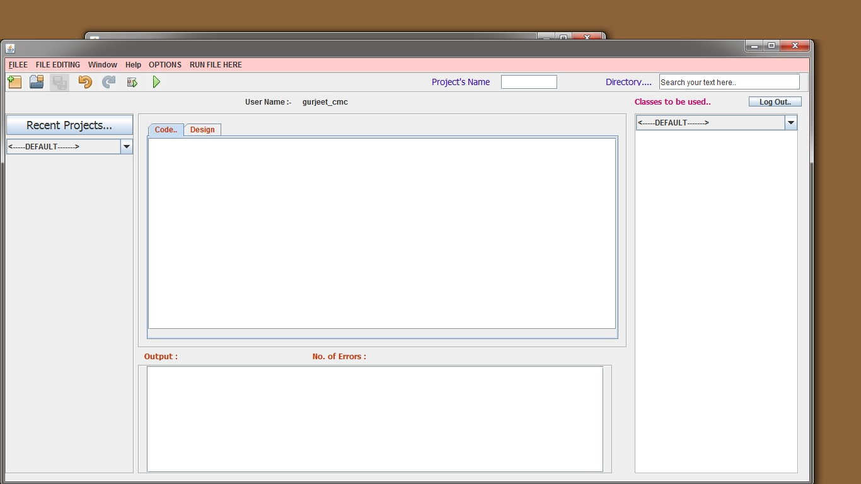
2) Main Interface..

Slide 14
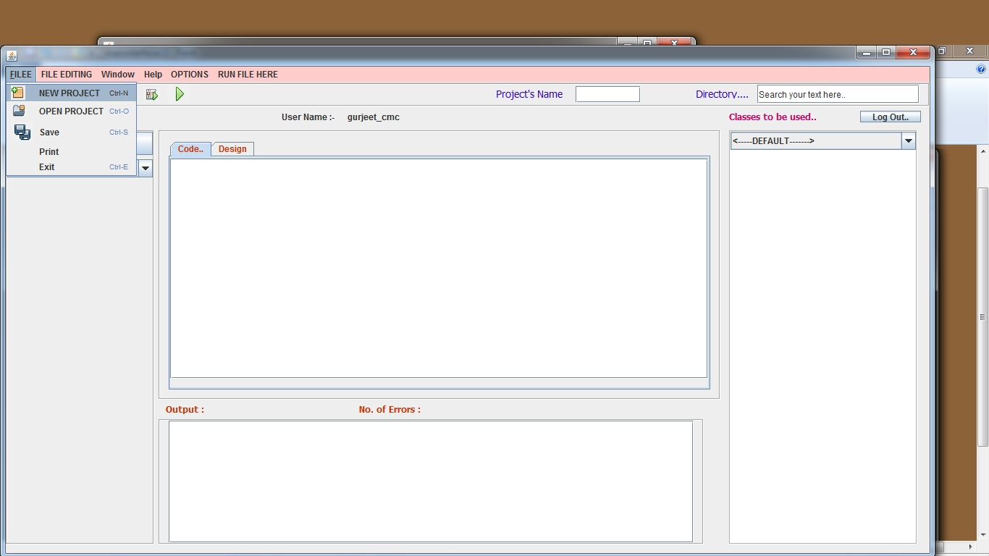
3) Creating new Project

Slide 15
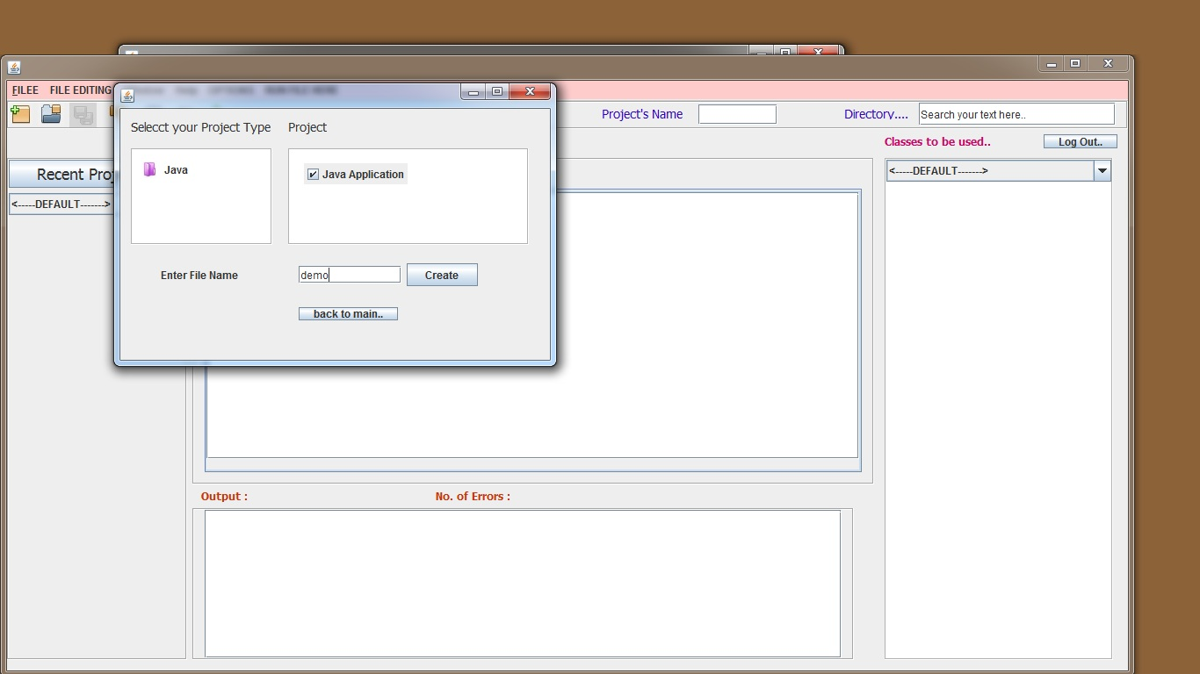
continue..

Slide 16
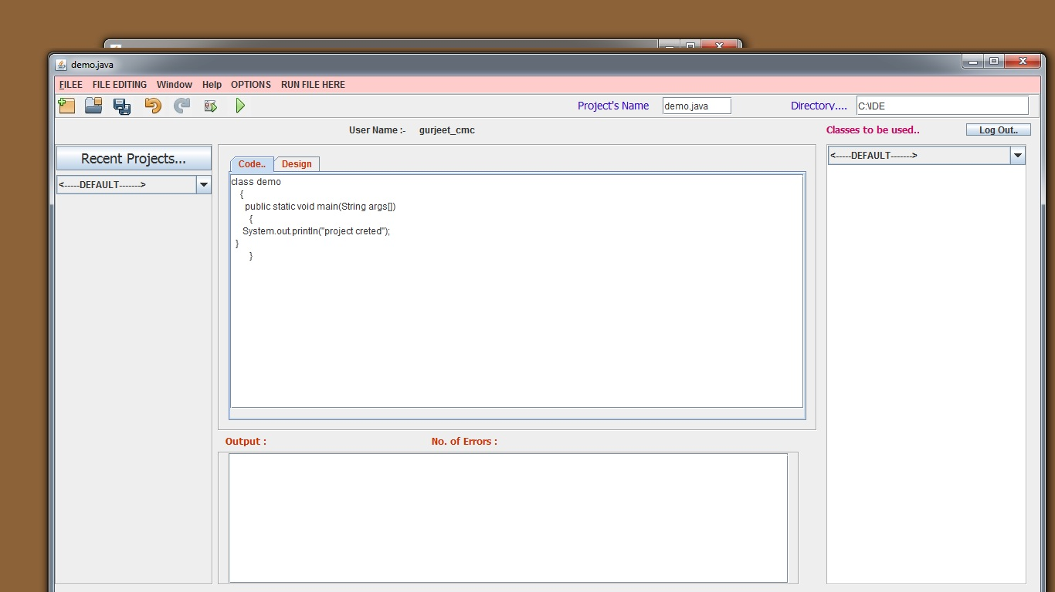
continue..

Slide 17
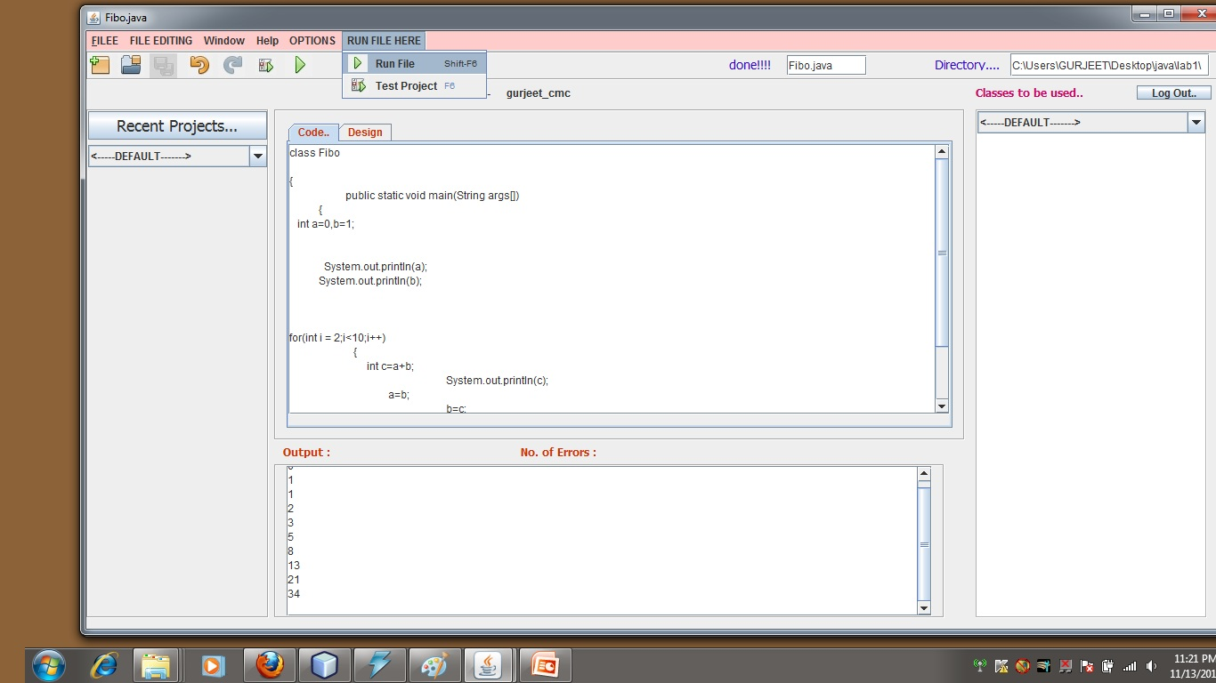
continue..

Slide 18
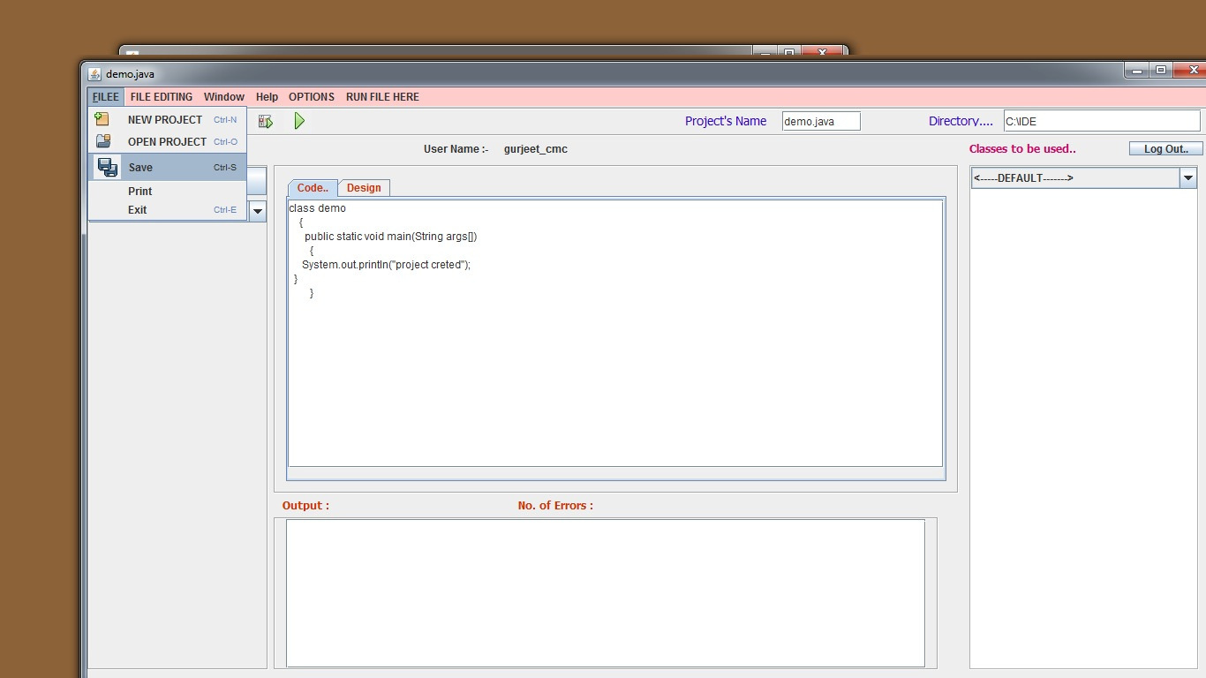
4) SavingProject

Slide 19
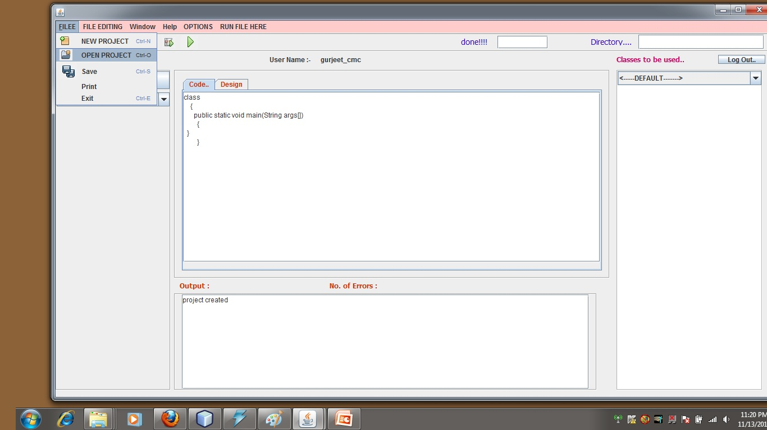
5) Opening another Project

Slide 20
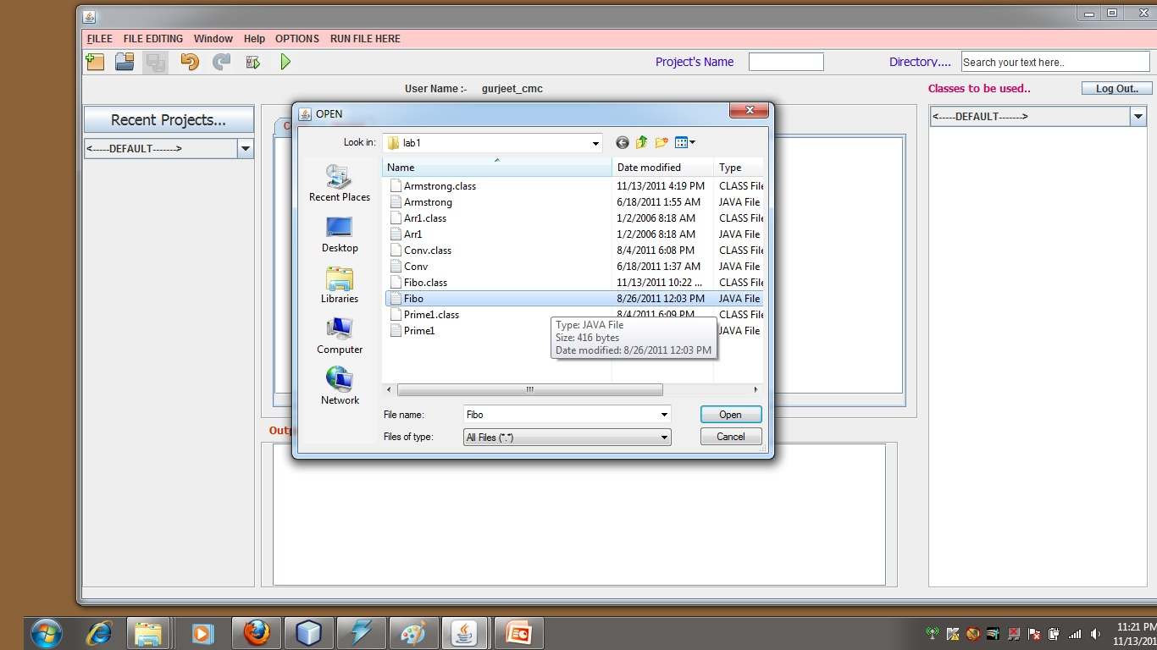
continue..

Slide 21
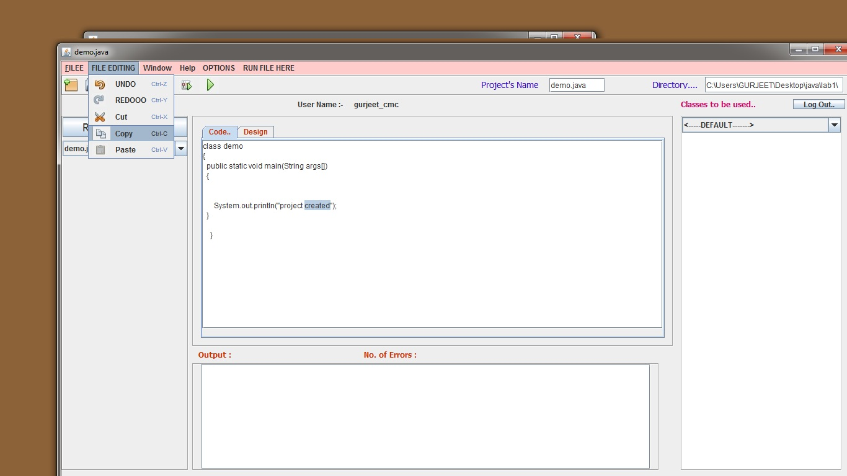
6) Text Manipulation : Copy

Slide 22

Text Manipulation : Paste

Slide 23
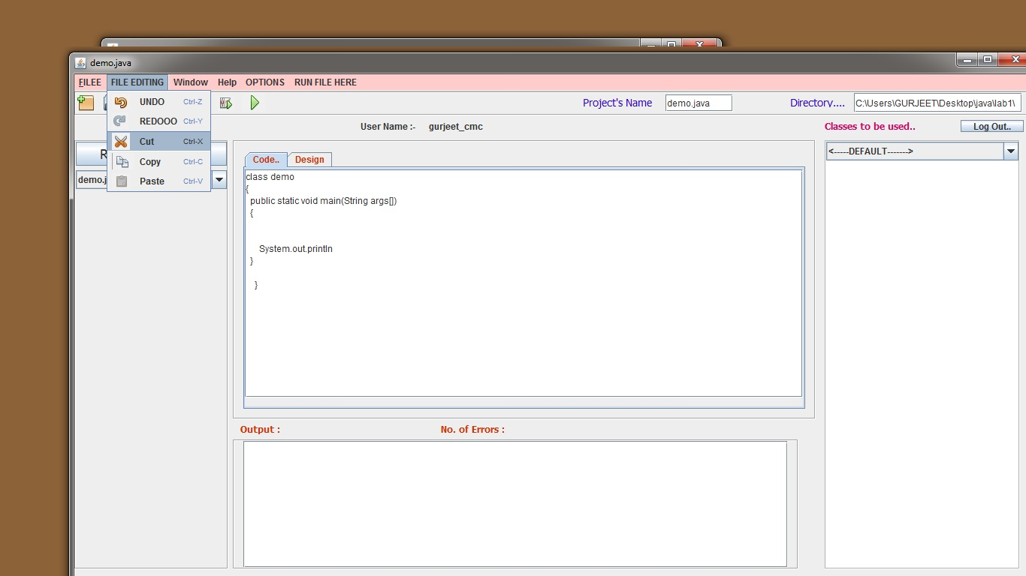
Text Manipulation : Cut

Slide 24

7) Typing error code

Slide 25

Saving again..

Slide 26
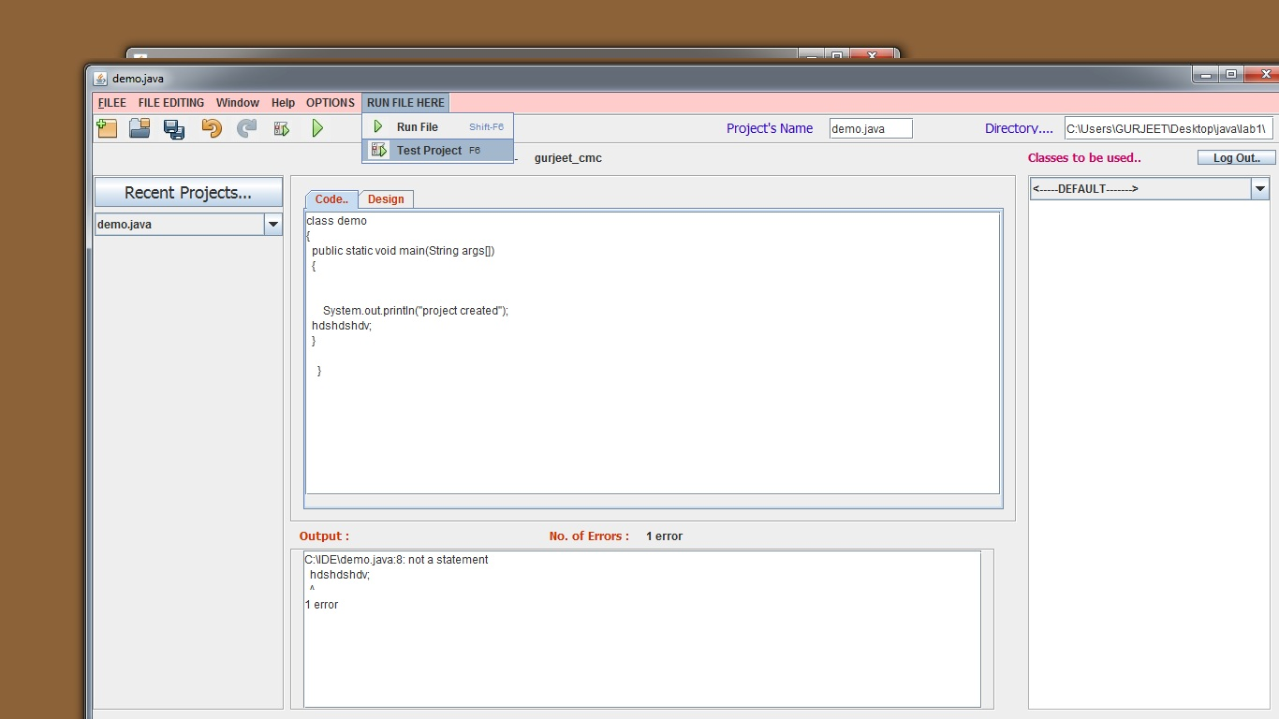
8) Code Compilation..

Slide 27

Removing error and saving again..

Slide 28
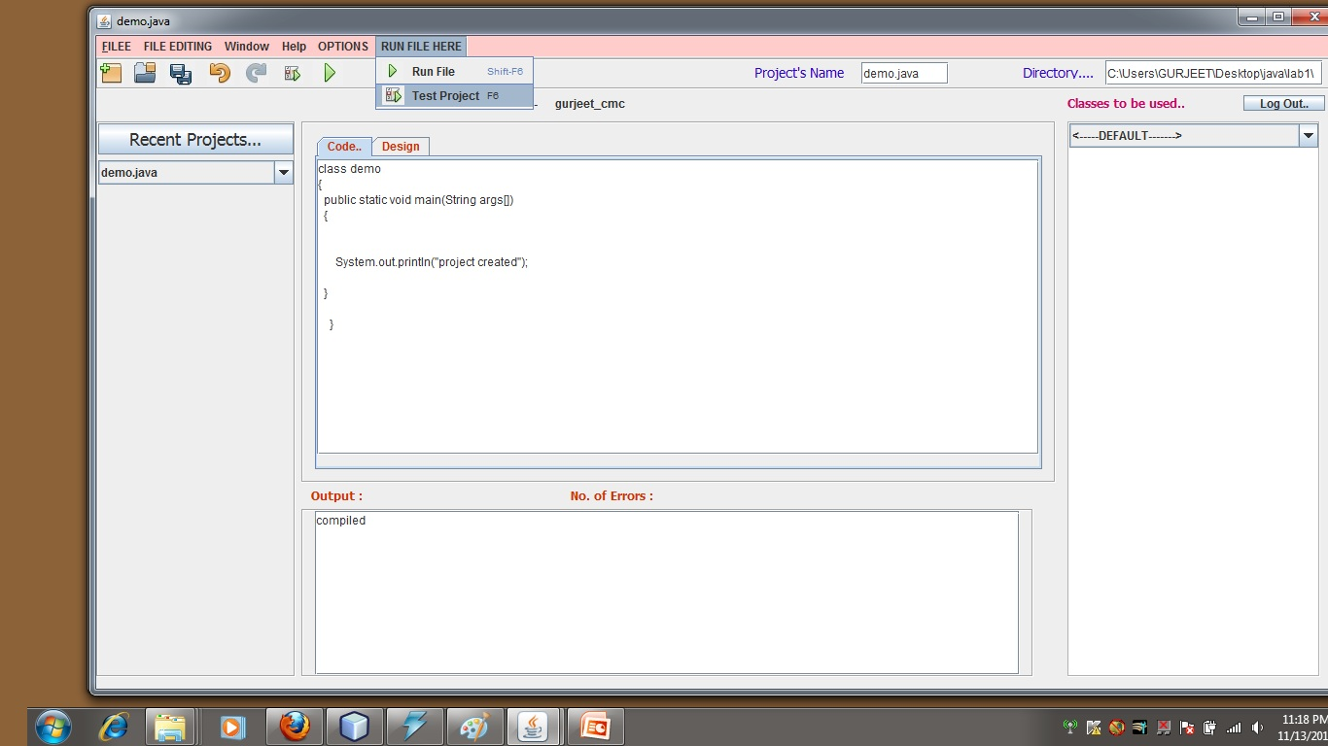
Compiling again..

Slide 29
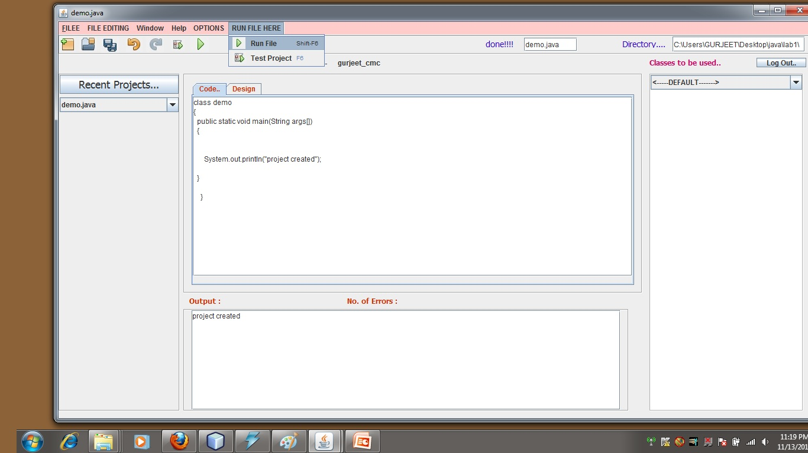
9) Interpreting the code..

Slide 30
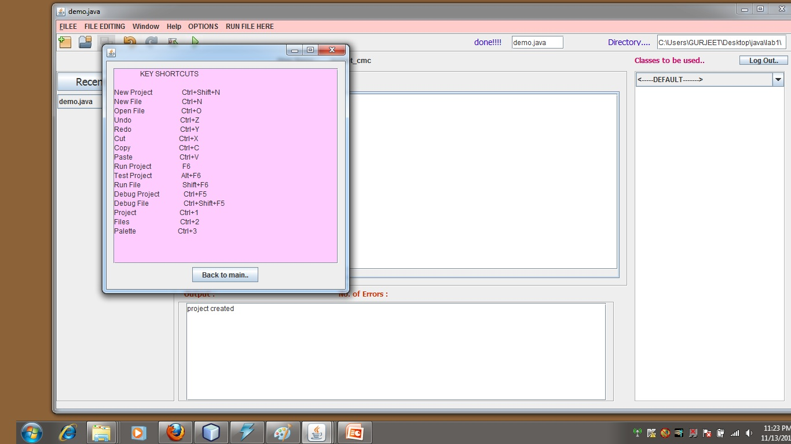
10) Shortcuts used

Slide 31
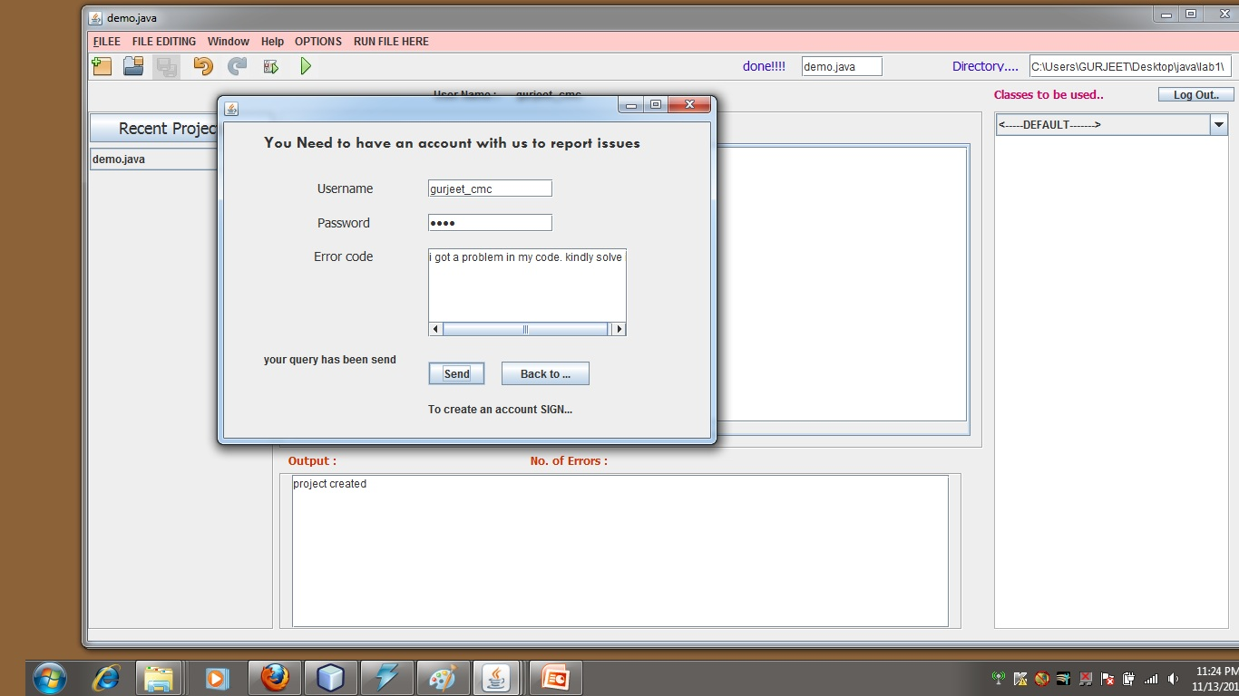
11) Report Issue

Slide 32
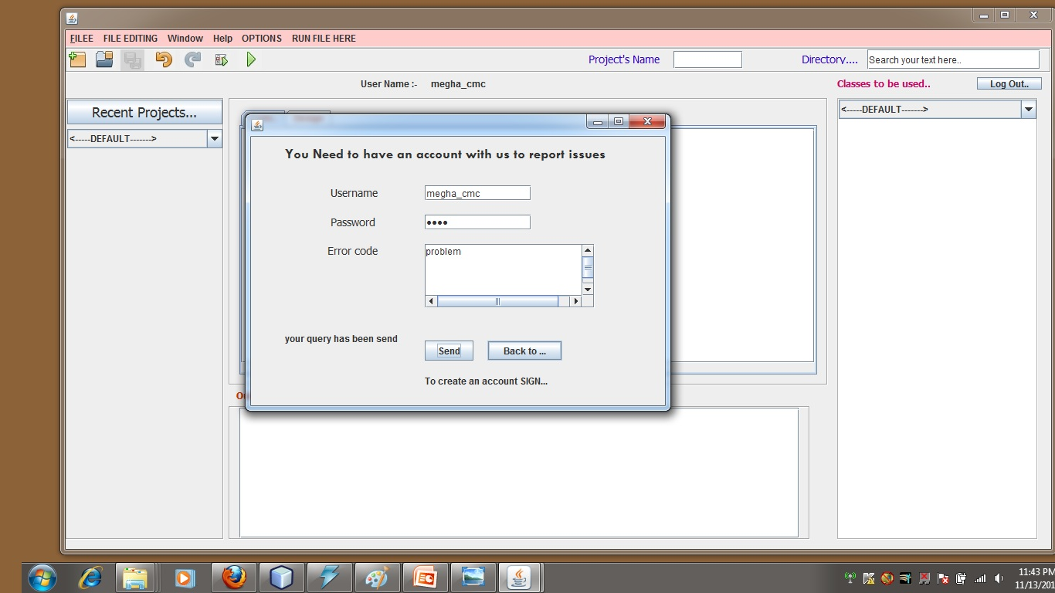
continue..

Slide 33
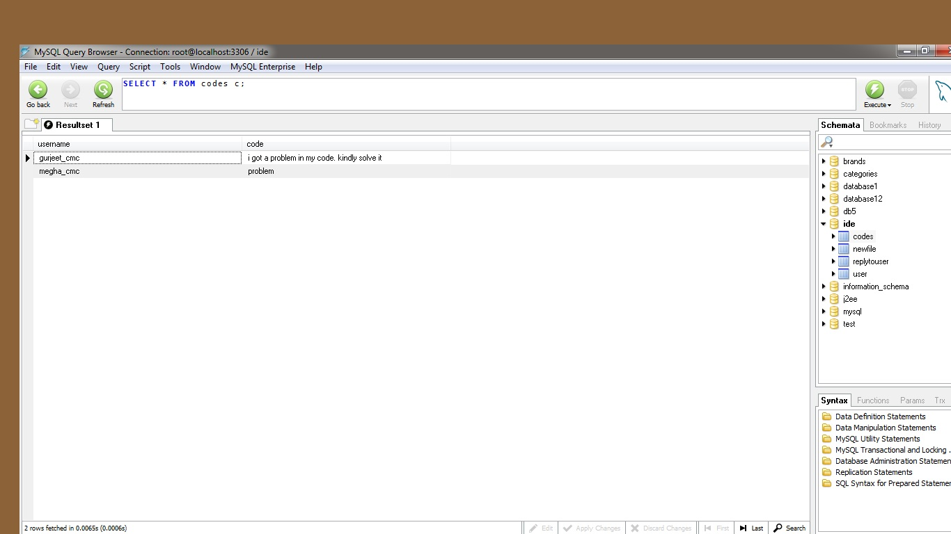
continue..

Slide 34
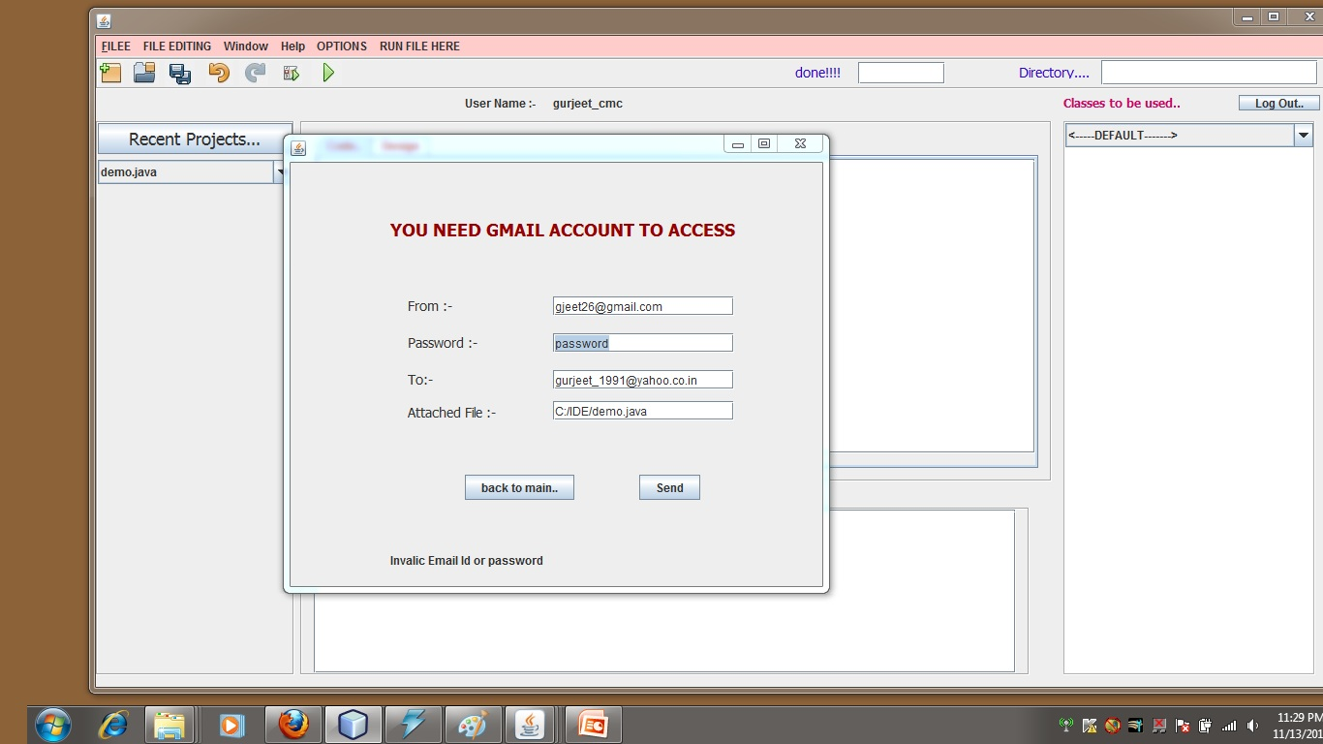
12) Sending code via Web

Slide 35
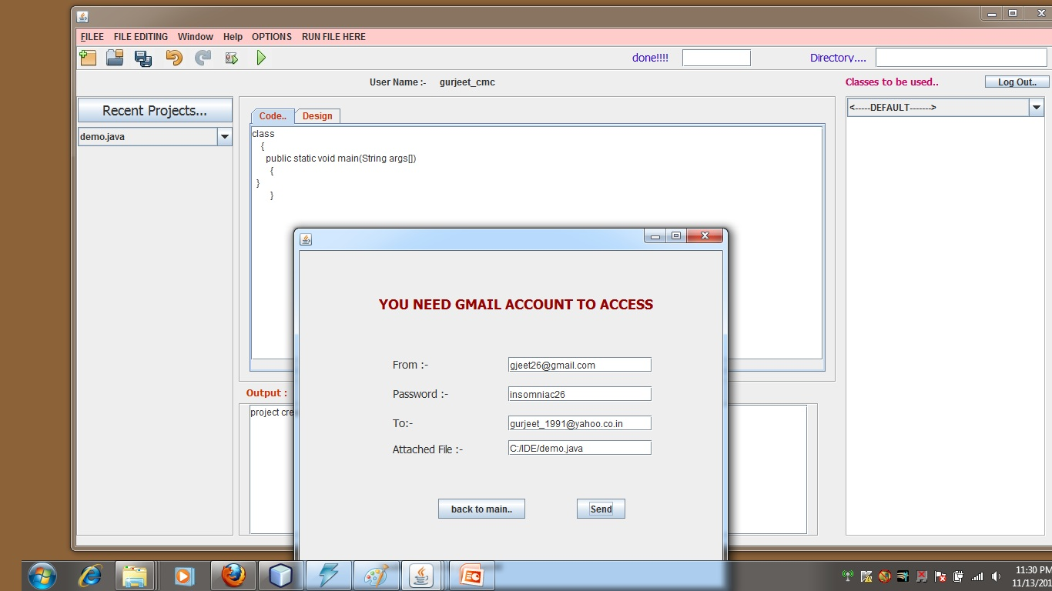
continue..

Slide 36
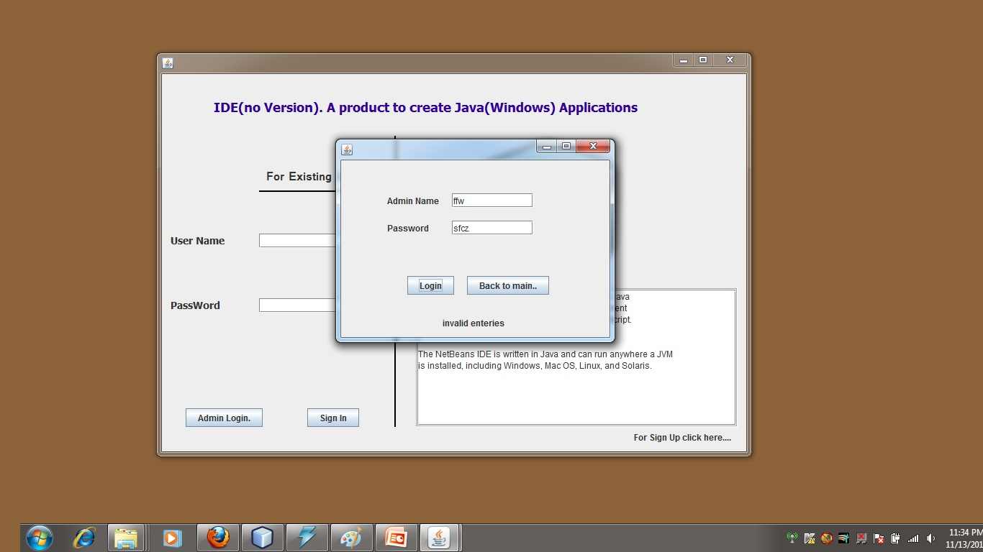
13) Admin Login

Slide 37
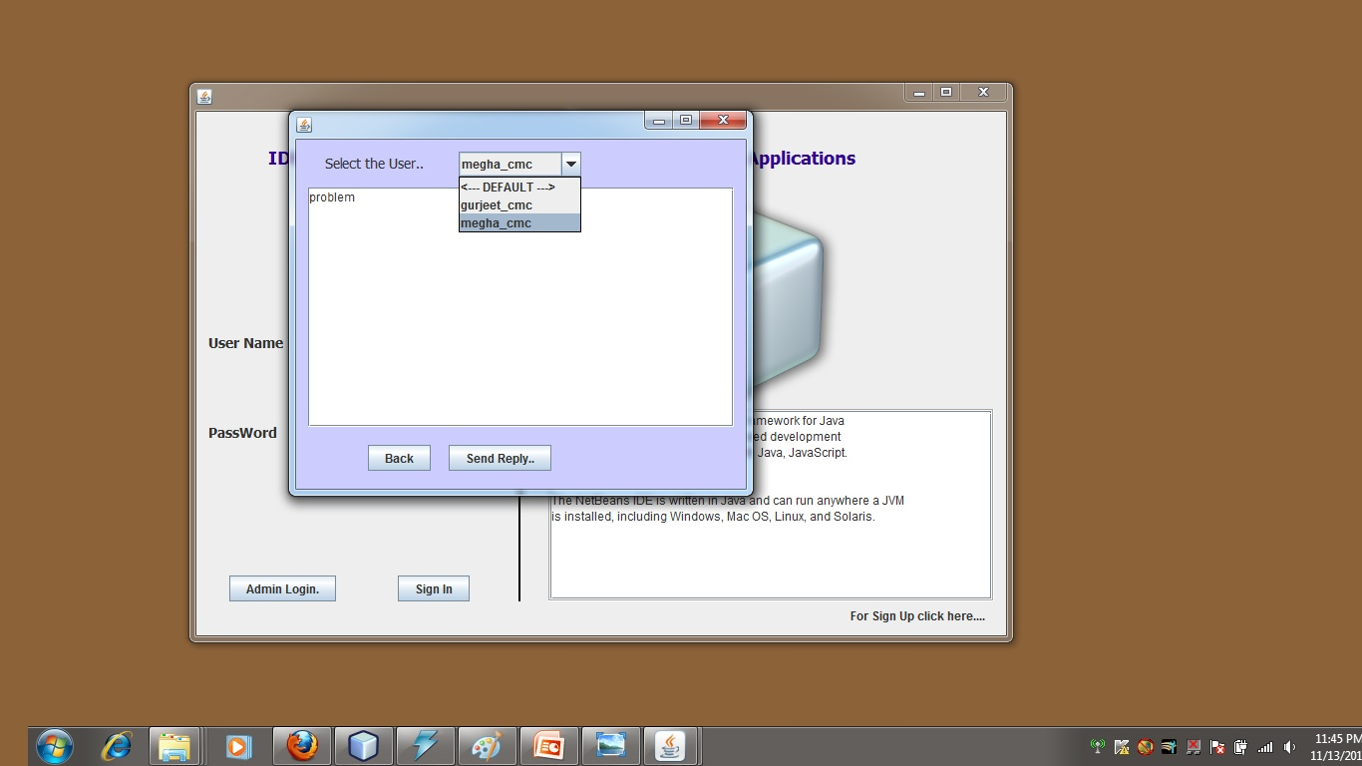
14) Handling Query

Slide 38
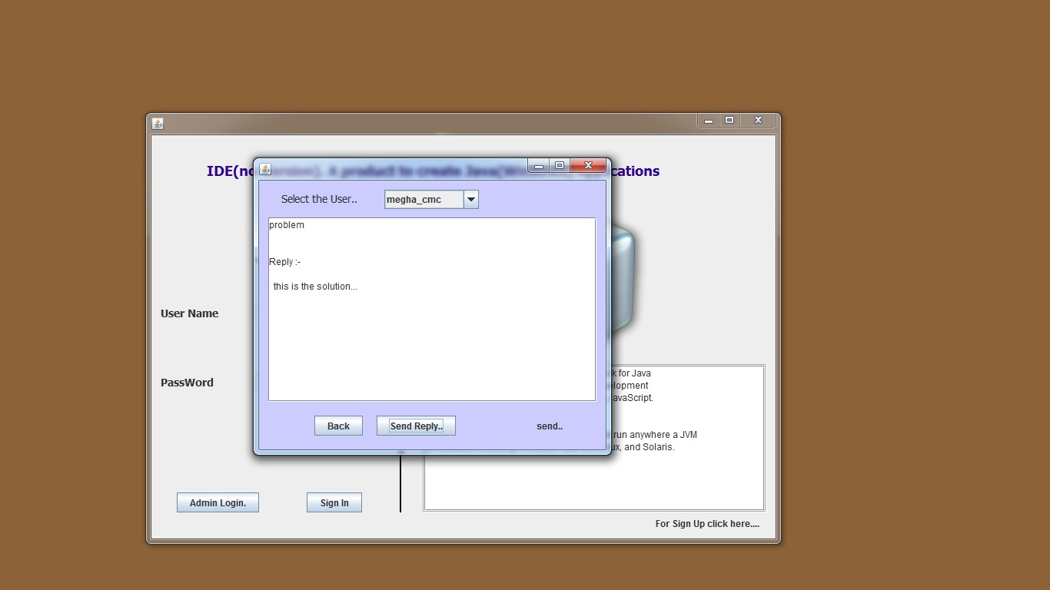
continue..

Slide 39
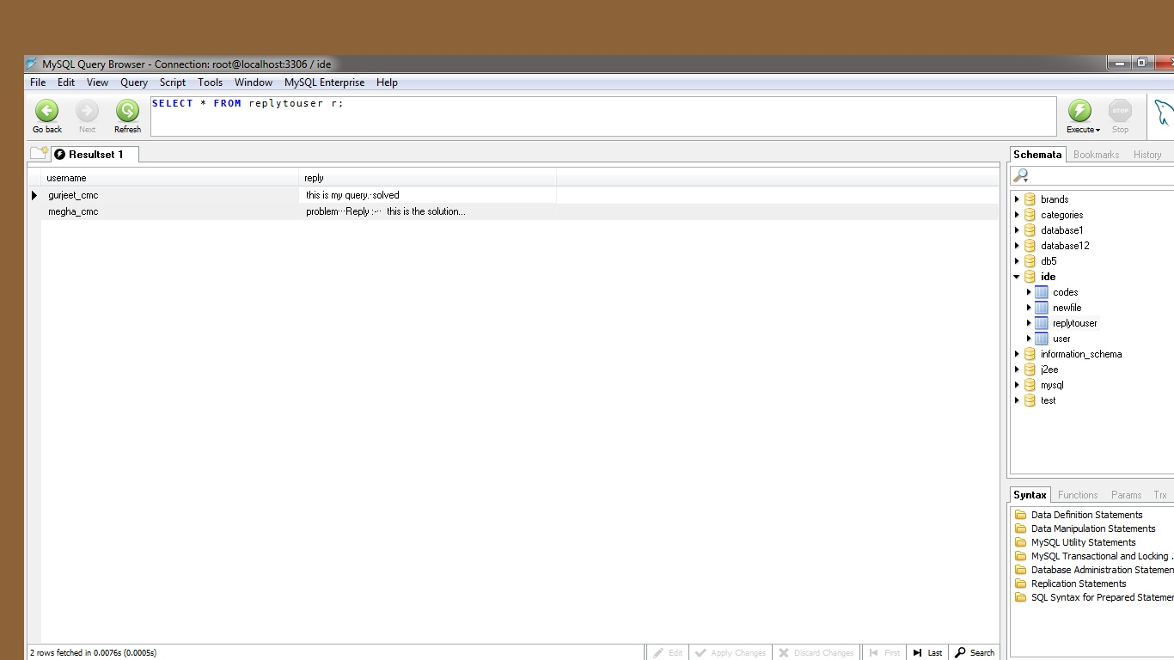
continue..

Slide 40
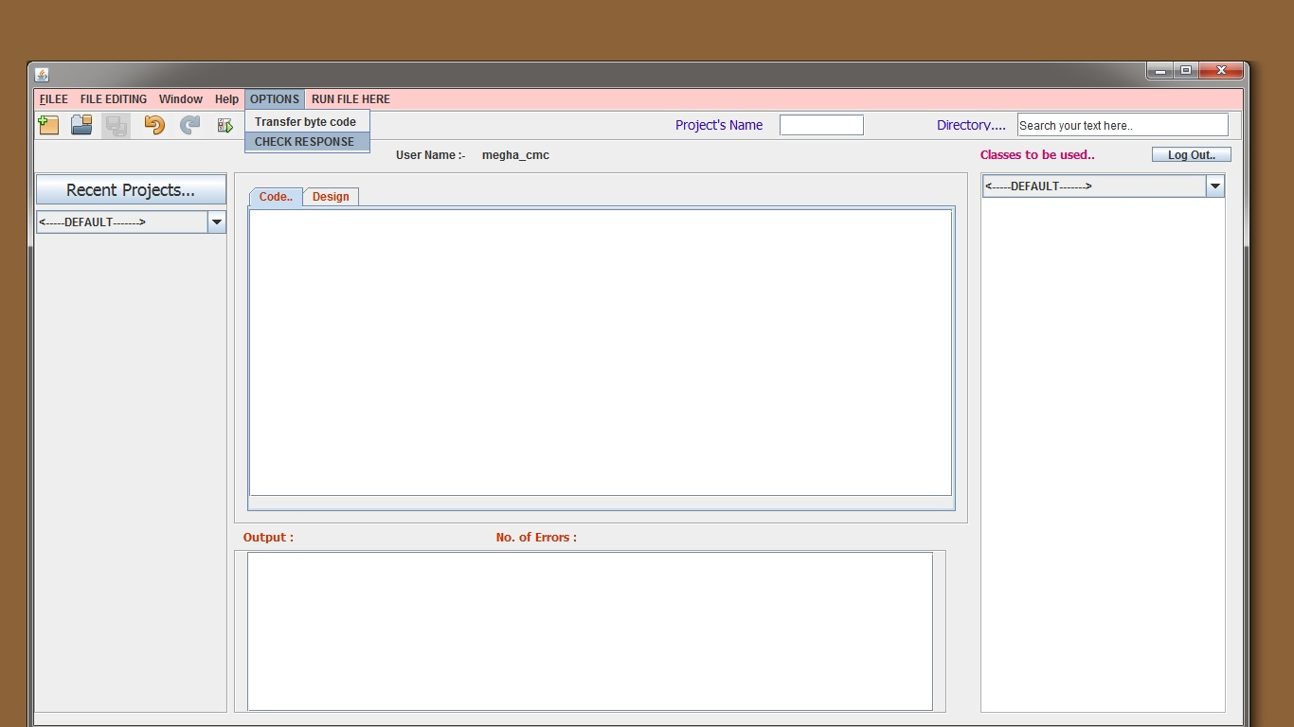
15) Checking reply at user Side

Slide 41
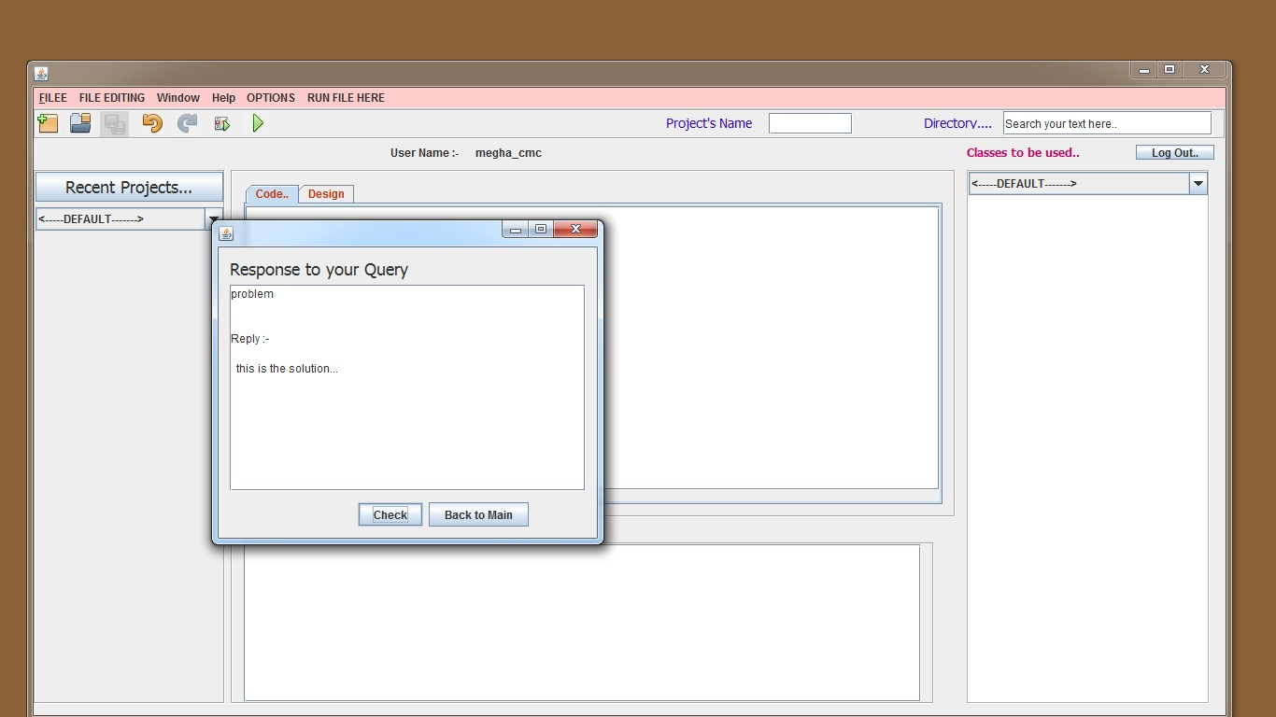
continue..

Slide 42
REFERENCES
1.http://apl.jhu.edu/~hall/java/IDEs.html
2. http://faq.programmerworld.net/
3. http://netbeans.org/
4. http://www.jcreator.com/

Slide 43
THANK YOU

